Slide 1
Fundamentals of Computer Networks and Management
Atul Kahate

Slide 2
Sessions 1 and 2

Slide 3
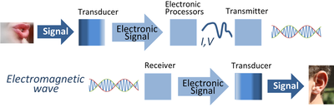
Electronic Communication System

Slide 4
Introduction to Communication System
Communication system allows exchange of data between two stations, transmitter and receiver
Signals pass from source to destination through what is called channel, which represents a way that signal use it to move from source toward destination
To transmit signals in communication system, it must be first processed in several stages, beginning from signal representation, to signal shaping until encoding and modulation
After preparing the transmitted signal, it is passed to the transmission line of channel
Due to the signal crossing this media it faces many impairments such as noise, attenuation and distortion

Slide 5
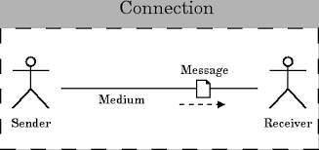
Components of a Data Communication System
Transmission device or Sender
A device that actually sends out the message.(eg computer , telephone, etc).
A medium
A physical channel where the information travels from the sender to the receiver.
Message
The data/information to be transmitted. It can be in the form of text, audio, video, photos, or combination of them.
Receiving device or Receiver
A device that receives the message then process the information in the message.

Slide 6
Issues in Computer Networking
Sharing computer resources
Interaction between computers
Network applications
Physical data transmission
Encoding
Physical link characteristics
Interaction among several computers
Topology
Addressing
Switching

Slide 7
Network Hardware and Software
Two types of transmission technology: Broadcast links and Point-to-point links
Broadcast network
The communication channel is shared by all the machines on the network
Packets sent by any machine are received by all the others.
An address field within each packet specifies the intended recipient.
A wireless network is a common example of a broadcast
Point-to-point network
Links connect individual pairs of machines
Point-to-point transmission with exactly one sender and exactly one receiver is sometimes called unicasting

Slide 8
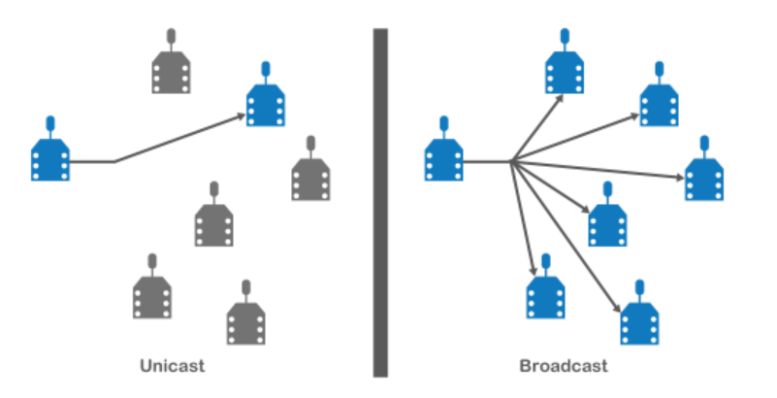
Unicast versus Broadcast

Slide 9
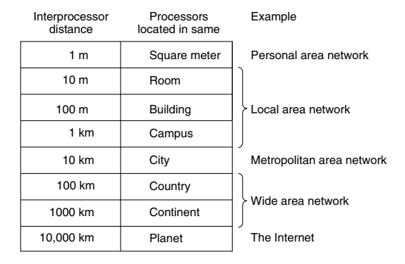
Scale and Network Types

Slide 10
Local Area Network (LAN)
Local Area Network (LAN): A privately owned network that operates within a single building like a home, office or factory
Wireless LANs: In these systems, every computer has a wireless modem and an antenna that it uses to communicate with other computers
An access point or base station controls the network
IEEE 802.11 standard (also called WiFi) describes this

Slide 11
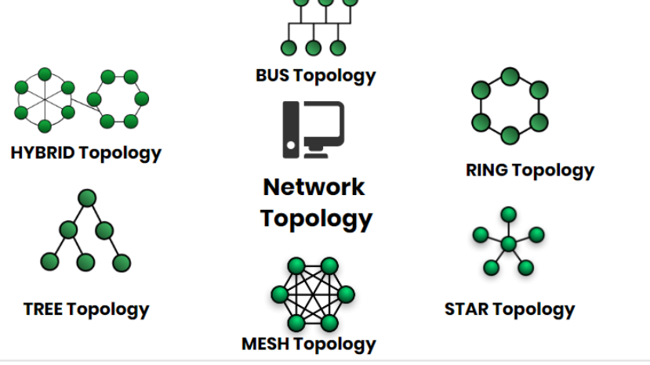
Network Topology
Network Topology represents a network arrangement consisting of several nodes

Slide 12
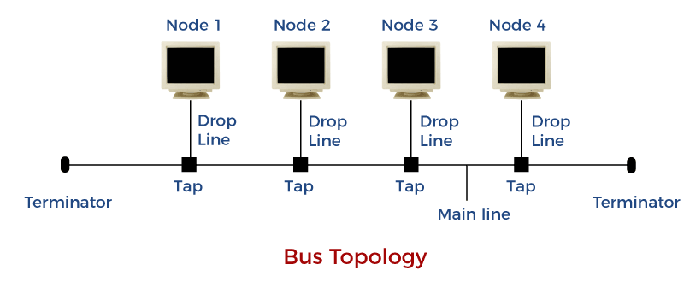
Bus Topology
All the nodes are connected to a common wire, called as bus
Simple and cost-effective, but all depends on a single cable, not fast

Slide 13
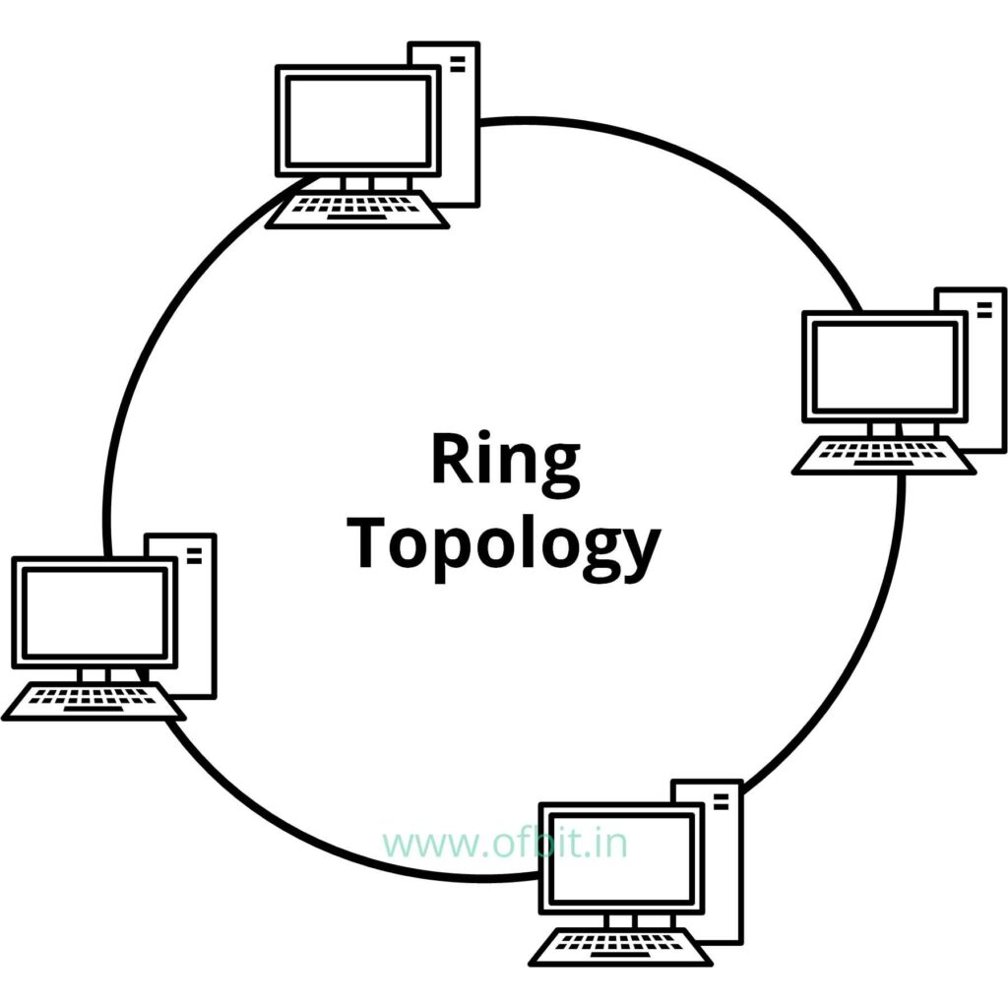
Ring Topology
One computer is connected to the next, and so on, to complete a ring
A transmitting computer needs to have a token, before transmitting
Inexpensive, Tough to add or remove nodes, One node crashing can disconnect the whole network

Slide 14
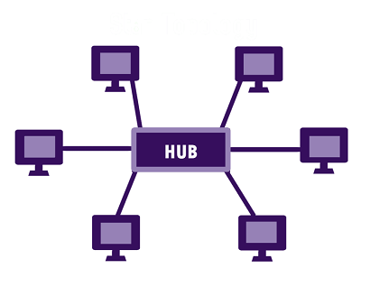
Star Topology
Each device is connected to a central hub
All communication goes through the hub only
Simple, too much of dependence on the hub, but the hub can be upgraded easily, Easy to troubleshoot, Cost is high

Slide 15
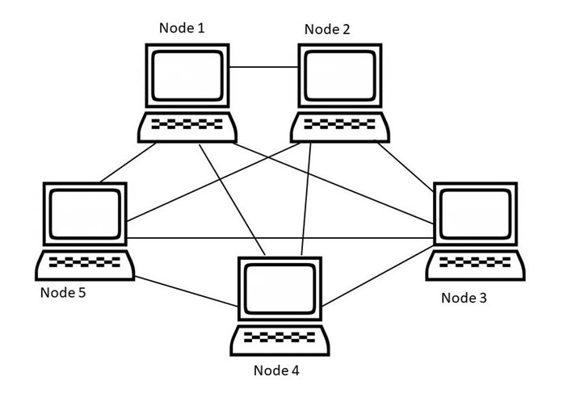

Mesh Topology
All nodes are connected to each other
Point-to-point connection, so for n nodes: $n x \left(n−1\right)÷2$ links
Very robust, Easy to diagnose errors, Privacy and security are better, Costly, Too much of wiring

Slide 16
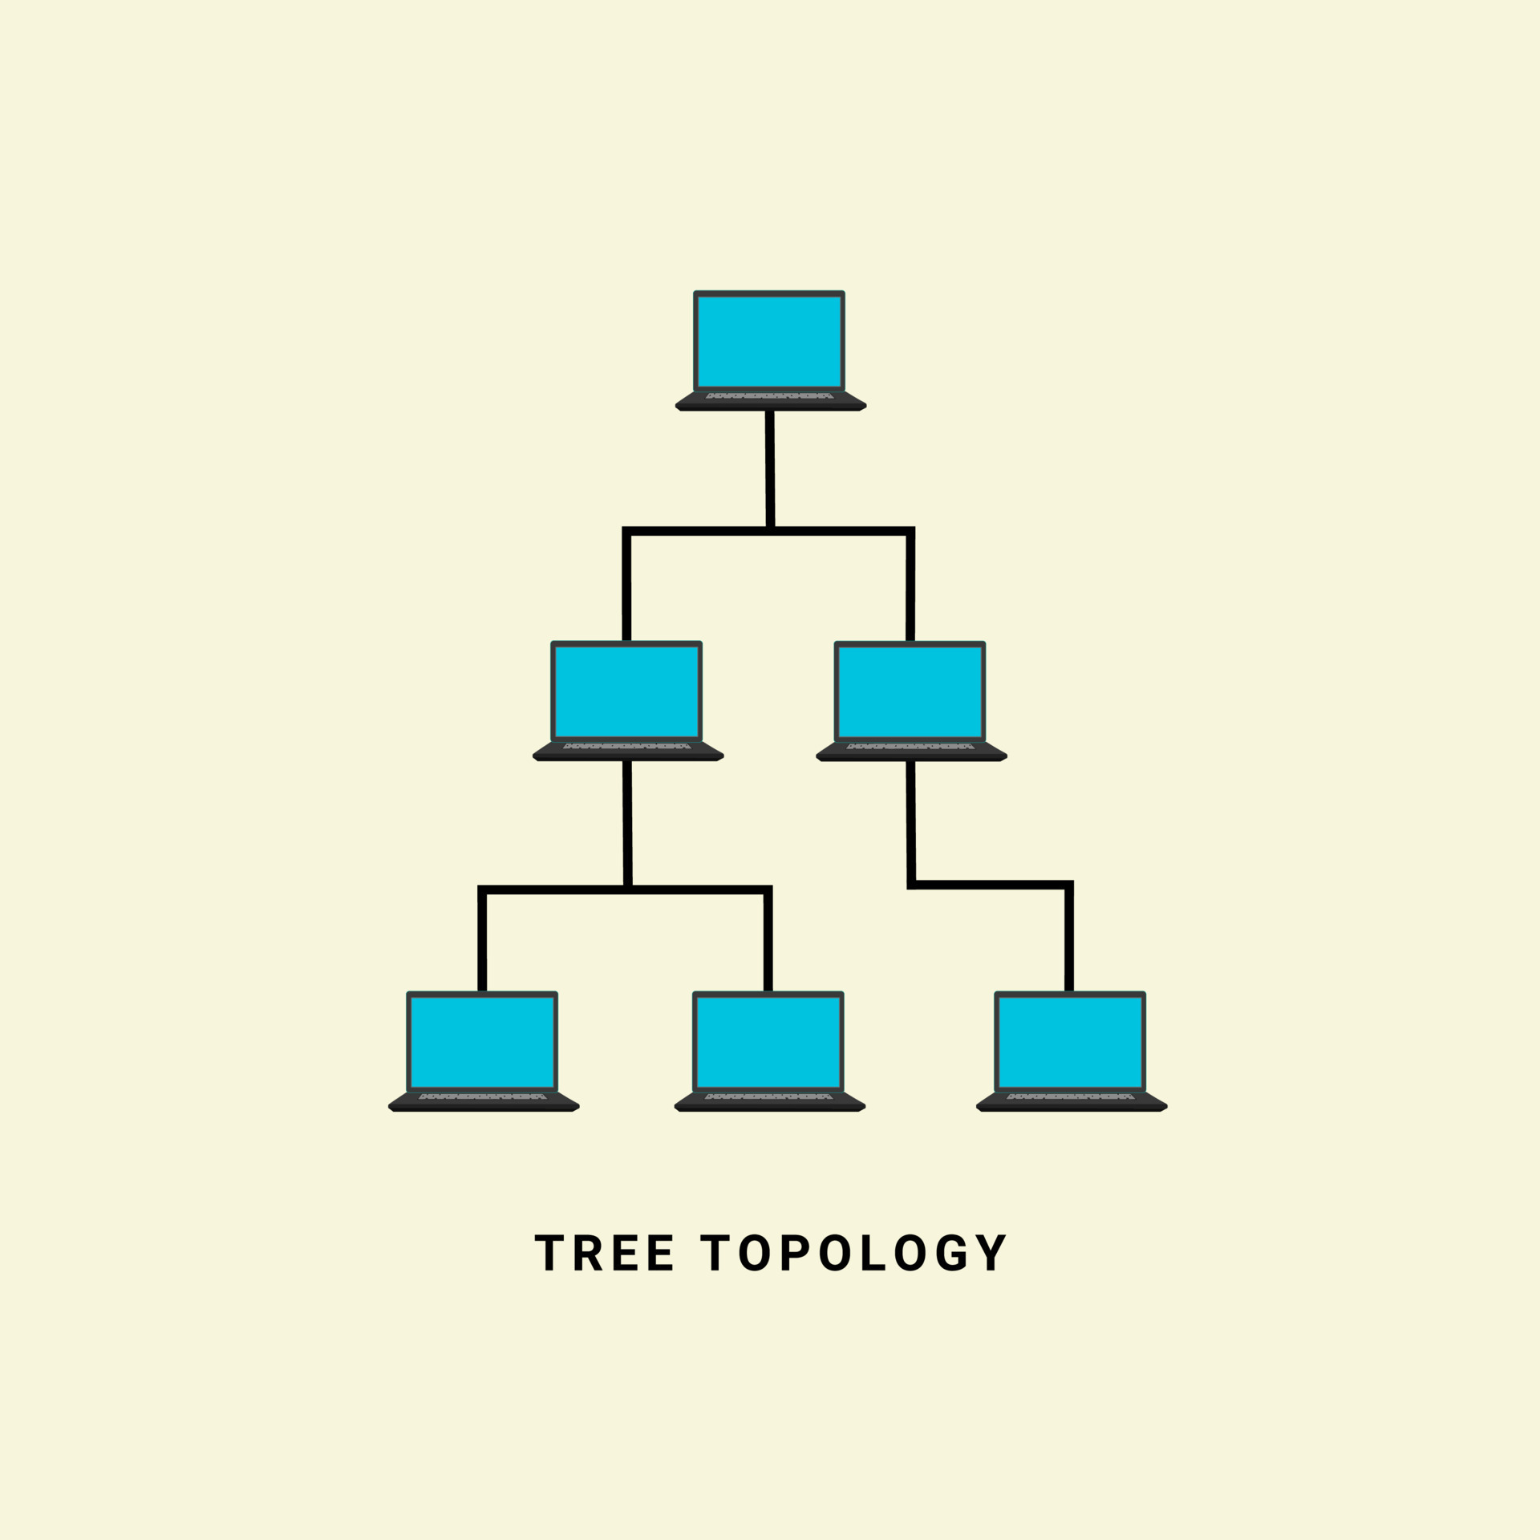
Tree Topology
Nodes are connected hierarchically, ultimately connecting to the top node, called as the root node
Has at least three levels of hierarchy
Easy to expand and manage, debug
Expensive, lot of cabling

Slide 17
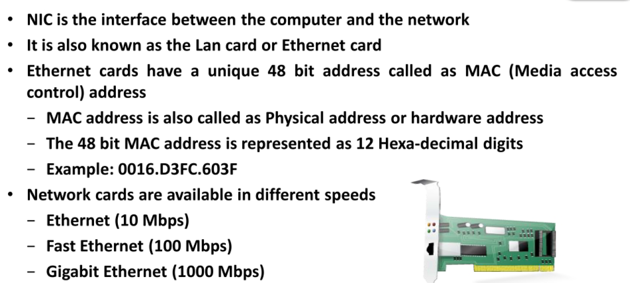
Network Interface Card (NIC)

Slide 18
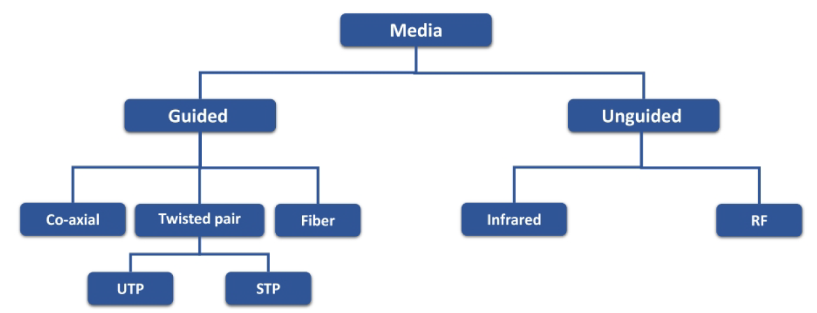
Transmission media

Slide 19
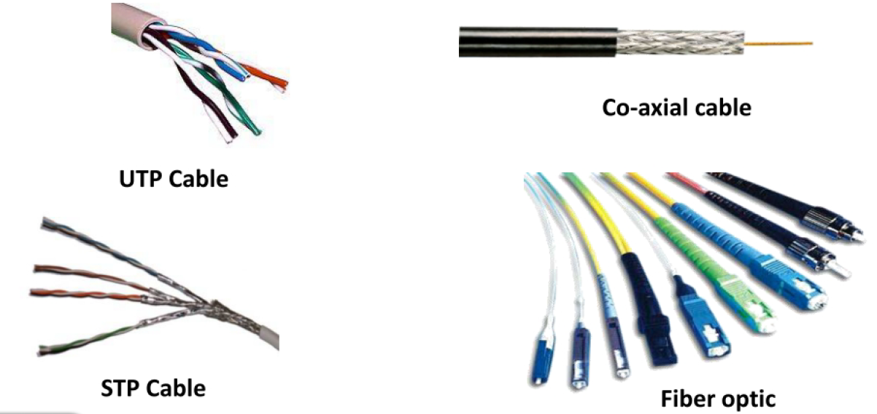
Transmission media

Slide 20
Transmission Media
Transmission medium: Carries information from a source to a destination
Guided media (Wired) include twisted-pair cable (uses electric current), coaxial cable (uses electric current), fiber-optic cable (uses light)
Unguided medium (Wireless) is air

Slide 21
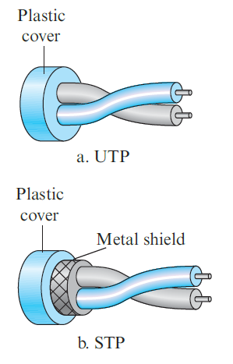
Twisted-pair cable
Consists of two copper wires
Two types
Unshielded twisted-pair (UTP)
Shielded twisted-pair (STP)
Used in telephone networks

Slide 22
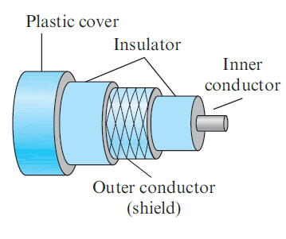
Coaxial cables
Coaxial cable (or coax) carries signals of higher frequency ranges than those in twisted-pair cable
Instead of having two wires, coax has a single copper wire
Usage: Telephone, Cable TV, LAN

Slide 23
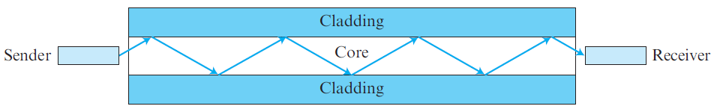
Fiber-optic cable
Made of glass or plastic and transmits signals in the form of light
Modern Ethernet is fiber optic-based

Slide 24
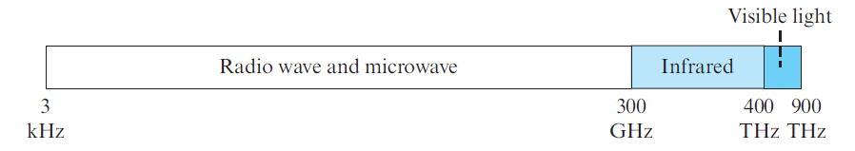
Unguided media
Use electromagnetic waves – no wire is needed
Also called as wireless communication
Signals are normally broadcast through free space and thus are available to anyone who has a device capable of receiving them
The part of the electromagnetic spectrum, ranging from 3 kHz to 900 THz is used for wireless communication.

Slide 25
Ethernet
Most popular LAN technology
Earlier, we also had Token Ring, Token Bus, etc
Ethernet generations
Standard Ethernet (10 Mbps)
Fast Ethernet (100 Mbps)
Gigabit Ethernet (1 Gbps)
10 Gigabit Ethernet (10 Gbps)

Slide 26
Earlier Ethernet – Classic Ethernet
Carrier sense multiple access with collision detection (CSMA/CD) technique was used
Allow any host to send data
If two hosts transmit at the same time, collision happens
They recover using CSMA/CD

Slide 27
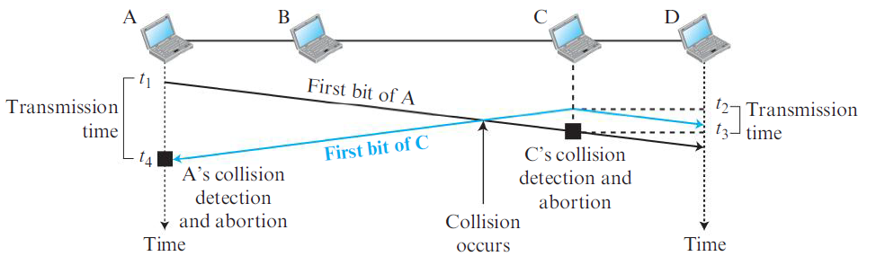
CSMA/CD

Slide 28
Modern Ethernet: Switched Ethernet
Devices called switches are used to connect different computers
Classic Ethernet is the original form and ran at rates from 3 to 10 Mbps
Switched Ethernet
Fast Ethernet: 100 Mbps
Gigabit Ethernet: 1000 Mbps (1 Gbps)
10 Gigabit Ethernet: 10,000 Mbps (10 Gbps)
In practice, only switched Ethernet is used nowadays

Slide 29
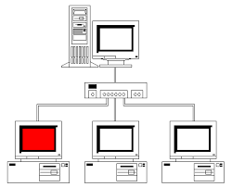
Switched Ethernet
Hosts connect into switches, and switches connect to each other
Ethernet switch

Slide 30
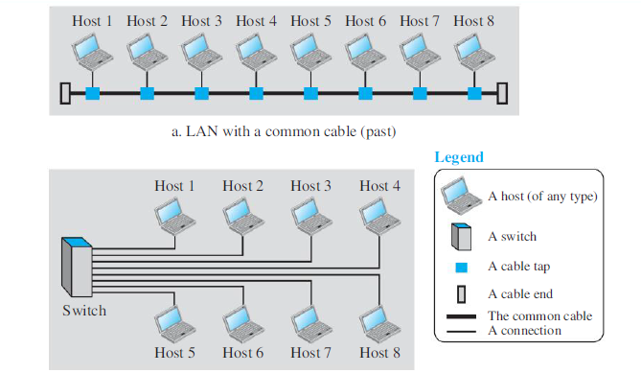
LAN – Earlier and Now

Slide 31
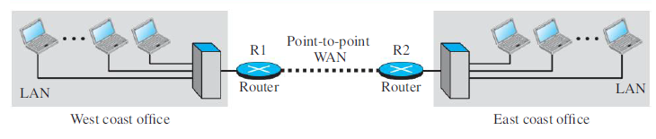
Wide Area Network (WAN)
A Wide Area Network (WAN) spans a large geographical area, often a country or continent
Example: Two LANs can be connected to form a WAN

Slide 32
Sessions 3 and 4

Slide 33
Protocol
Communication between two people or two devices needs to follow some protocol
A protocol is a set of rules that governs communication
For example, in a face-to-face communication between two persons, there is a set of implicit rules in each culture that define how two persons should start the communication, how to continue the communication, and how to end the communication

Slide 34
Network Software
Network software uses a protocol stack
A protocol stack contains many layers or levels
Each layer provides some services to the layer above it
Each layer hides complexity of its work from the layer above it
Creates a protocol hierarchy

Slide 35
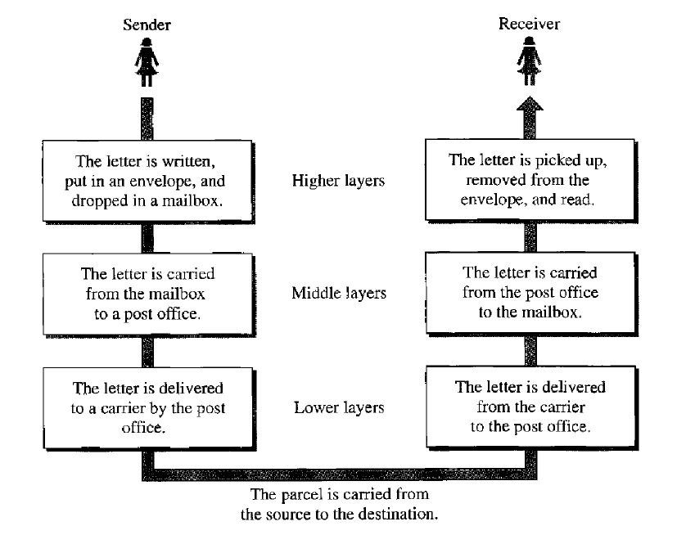
Protocol Hierarchy Example

Slide 36
OSI
Open Systems Interconnection
Good in theory, not used in practice
Contains 7 layers
Sometimes also called ISO/OSI

Slide 37
Layers in OSI
Application Layer
Presentation Layer
Session Layer
Transport Layer
Network Layer
Data Link Layer
Physical Layer
Notes:
37

Slide 38
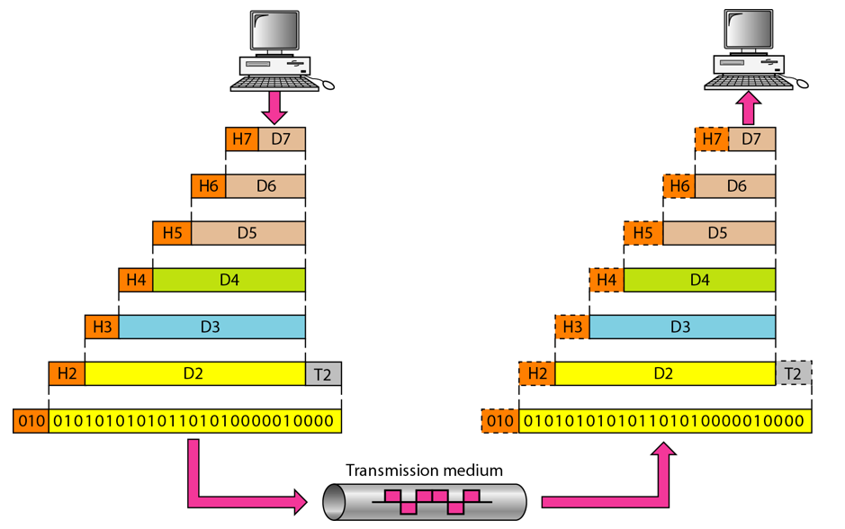
An Exchange using the OSI Model

Slide 39
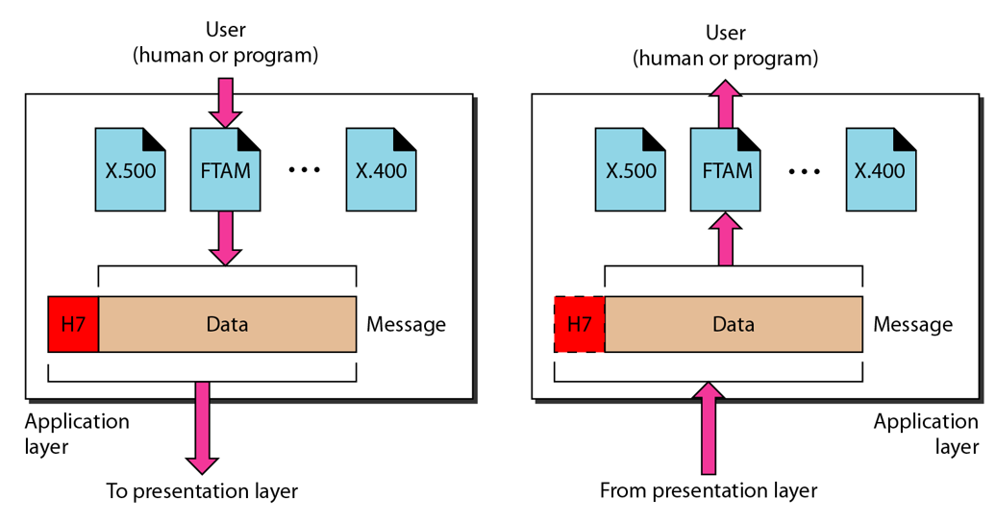
The Application Layer

Slide 40
Application Layer
Provides an “application view” to a network (e.g. email, file transmission)
Example: Hypertext Transfer Protocol (HTTP) is used to access Web pages
Encapsulation begins here
Other examples: Email (SMTP), File transfers (FTP), Querying domain names (DNS)

Slide 41
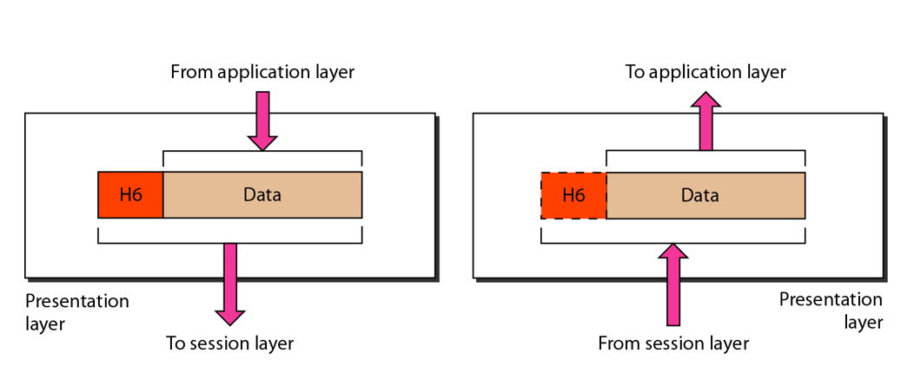
The Presentation Layer

Slide 42
Presentation Layer
Translation: Use of a common format to take care of differences (encoding, number representation etc)
Encryption: To achieve confidentiality or privacy
Compression: Reduces the number of bits needed to be transmitted

Slide 43
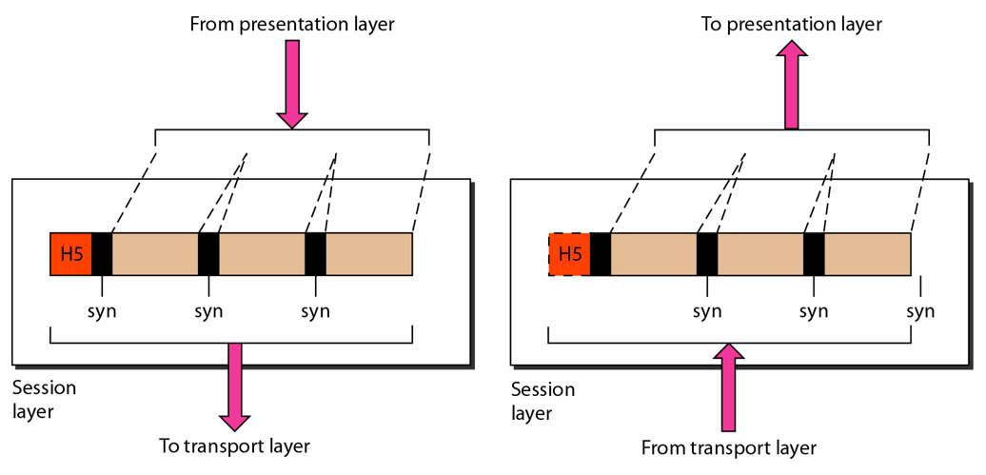
The Session Layer

Slide 44
Session Layer
Manages the session between applications
Example: Between browser of the source computer and server of the destination computer

Slide 45
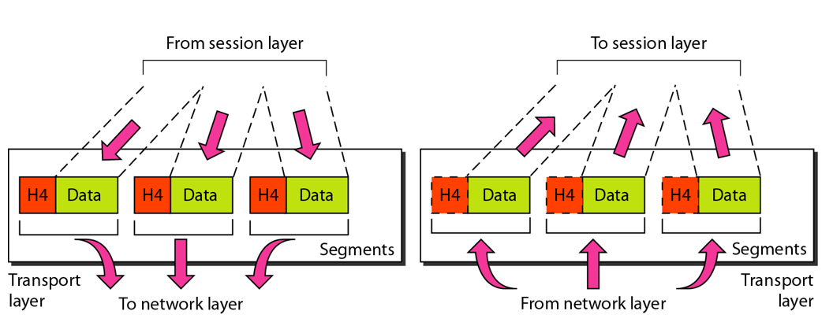
The Transport Layer

Slide 46
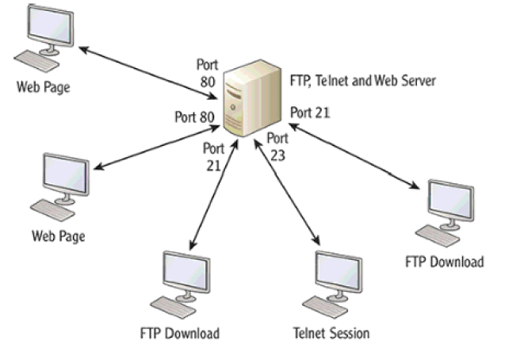
Transport Layer
Identifies the application on the destination computer using port numbers
Example: One server, multiple applications

Slide 47
Port Numbers
Port number is a 16-bit value, so it can store a number between 0 and 65,535
Port Number Range | Where used? | Called as
0-1023 | Server | Well-known ports
1024-49151 | Client | Temporary/Ephemeral
49152-65535 | NA | Dynamic, Usage-based

